Slide 1
FLOW CONTROL STATEMENTS

Slide 2
FLOW CONTROL STATEMENTS
Are capable of controlling (changing) sequential execution flow of a program, based on some decision or unconditionally
FLOW CONTROL STATEMENTS
IF SWITCH LOOPING CONDITIONAL goto
if STATEMENTS OPERATOR continue
if-else while break
if-elseif for
do-while

Slide 3
if
if(expression)
{
statements
}
Statements in the body will be executed if expression evaluates to be true
Statements in the body will be by-passed if expression evaluates to be false
Pair of { } is optional if there is only one statement in the body
TRUE
FALSE

Slide 4
If code Example 1
Program to find greater of two numbers :
#include<stdio.h>
int main( )
{
int i=0,j=0;
printf(“\nenter two numbers : ”);
scanf(“%d%d”,&i,&j);
if(i > j)
{
printf("\n %d is greater“,i);
}
if(i < j)
printf("\n %d is greater“,j);
if(i == j)
printf(“\nnumbers are equal”);
return 0;
}

Slide 5
If code Example 2
Menu driven Program for addition, subtraction or multiplication of two numbers :
#include<stdio.h>
int main( )
{
int i=0,j=0,r=0;
char ch=0;
printf(“\nenter two numbers : ”);
scanf(“%d%d”,&i,&j);
printf(“\nA.addition B.subtraction C.multiplication enter your choice : ”);
scanf(“%c”,&ch);
if(ch == ‘A’)
{
r = i + j;
printf("\n addition : %d “,r);
}
if(ch == ‘B’)
{
r = i - j;
printf("\n subtraction : %d “,r);
}
if(ch == ‘C’)
{
r = i * j;
printf("\n multiplication : %d “,r);
}
return 0;
}

Slide 6
If (nested if )code Example 3
Program to check whether given alphabet is lowercase or uppercase :
#include<stdio.h>
int main( )
{
char c=0;
printf(“\nenter an alphabet : ”);
scanf(“%c”,&c);
if( c >= ‘a’)
{
if( c <= ‘z’)
printf("\n %c is a lower case“,c);
}
if( c >= ‘A’)
{
if( c <= ‘Z’)
printf("\n %c is an upper case“,c);
}
return 0;
}

Slide 7
if-else
if(exp)
{
statements
}
else
{
statements
}
TRUE
Statements in if part will be executed if expression evaluates to be true
Statements in else part will be executed if expression evaluates to be false
Pair of { } is optional if there is only one statement in the body (for if & else both)
FALSE

Slide 8
If-else code Example 1
Program to find greater of two numbers :
#include<stdio.h>
int main()
{
int i=0,j=0;
printf(“\nenter two numbers : ”);
scanf(“%d%d”,&i,&j);
if(i>j)
printf("\n %d is greater",i);
else
printf("\n %d is greater",j);
return 0;
}

Slide 9
If-else code Example 2
Program to check whether given number is even or odd :
#include<stdio.h>
int main()
{
int i=0;
printf(“\nenter a number : ”);
scanf(“%d”,&i);
if(i%2 == 0)
printf("\n %d is even",i);
else
printf("\n %d is odd",i);
return 0;
}

Slide 10
Logical operators
  && AND
  expr1 && expr2 returns 0 (false) or 1 (true)
    If expr1 is null , expr2 is not taken into account and the return value is 0
    If expr1 is non null & expr2 is null, the return value is 0
    If expr1 & exp2 both are non null the return value is 1
  || OR
  expr1 || expr2 returns 0 (false) or 1 (true)
    If expr1 is non null , expr2 is not taken into account and the return value is 1
    If expr1 is null & expr2 is non null, the return value is 1
    If expr1 & exp2 both are null the return value is 0
  ! NOT(logical Negation)

Slide 11
Logical operators code Example 1
Program to check whether given alphabet is lowercase or uppercase :
#include<stdio.h>
int main( )
{
char c=0;
printf(“\nenter an alphabet : ”);
scanf(“%c”,&c);
if( c >= ‘a’ && c <= ‘z’ )
printf("\n %c is a lower case“,c);
else
printf("\n %c is an upper case“,c);
return 0;
}

Slide 12
Logical operators code Example 2
Program to check whether given alphabet is vowel or consonant :
#include<stdio.h>
int main( )
{
char c=0;
printf(“\nenter an alphabet : ”);
scanf(“%c”,&c);
if( c==‘a’ || c==‘e’ || c==‘i’ || c==‘o’ || c==‘u’ )
printf("\n %c is vowel“,c);
else
printf("\n %c is consonant“,c);
return 0;
}

Slide 13
Logical operators code Example 3
Program to check whether given number is zero or non-zero :
#include<stdio.h>
int main()
{
int i=0;
printf(“\nenter a number : ”);
scanf(“%d”,&i);
if( ! i )
printf("\n %d is zero",i);
else
printf("\n %d is non-zero",i);
return 0;
}

Slide 14
if-elseif
if(exp)
{
statements
}
else if (exp)
{
statements
}
else if (exp)
{
statements
}
.
.
.
else
{
statements
}
Statements in if part whose exp turns to be true first in the sequence will be executed & remaining exp and else part is not taken into account
Statements in else part will be executed if all expressions evaluate to be false (else part is optional)
Pair of { } is optional if there is only one statement in the body (for if & else both)

Slide 15
If else if code Example 2
Menu driven Program for addition, subtraction or multiplication of two numbers :
#include<stdio.h>
int main( )
{
int i=0,j=0,ch=0,r=0;
printf(“\nenter two numbers : ”);
scanf(“%d%d”,&i,&j);
printf(“\n1.addition 2.subtraction 3. multiplication enter your choice : ”);
scanf(“%d”,&ch);
if(ch == 1)
{
r = i + j;
printf("\n addition : %d “,r);
}
else if(ch == 2)
{
r = i - j;
printf("\n subtraction : %d “,r);
}
else if(ch == 3)
{
r = i * j;
printf("\n multiplication : %d “,r);
}
else
printf("\n INVALID CHOICE“);
return 0;
}

Slide 16
If-else if code Example 1
Program to check whether given character is alphabet,number or special character :
#include<stdio.h>
int main( )
{
char c=0;
printf(“\nenter a character : ”);
scanf(“%c”,&c);
if( ( c >= ‘a’ && c <= ‘z’ ) || ( c >= ‘A’ && c <= ‘Z’ ) )
printf("\n %c is an alphabet“,c);
else if ( c >= ‘0’ && c <= ‘9’ )
printf("\n %c is a number“,c);
else
printf("\n %c is a special character“,c);
return 0;
}

Slide 17
SWITCH

Slide 18
switch(exp)
{
case V1: statements
break;
case V2: statements
break;
:
:
case Vn: statements
break;
default: statements
break;
}
Compares the expression to each case sequentially
When match found, executes code until a break keyword is reached
If no case value matches the expression, the default case is executed
break & default case are syntactically optional
Execution “falls through” if break not included

Slide 19
Switch code Example 1
Menu driven Program for addition, subtraction or multiplication of two numbers :
#include<stdio.h>
int main()
{
int i=0,j=0,ch=0;
printf(“enter two numbers : “);
scanf(“%d%d”,&i,&j);
printf(“1.add\n2.sub\n3.mul \n enter choice “);
scanf(“%d”,&ch);
switch(ch)
{
case 1: printf(“addition=%d“,i+j);
break;
case 2: printf(“subtraction=%d“,i-j);
break;
case 3: printf(“multiplication=%d“,i*j);
break;
default: printf(“invalid choice“);
break;
}
return 0;
}

Slide 20
Switch code Example 2
Program to check whether given number is even or odd :
#include<stdio.h>
int main()
{
int n=0;
printf(“enter no”);
scanf(“%d”,&n);
switch(n%2)
{
case 1: printf(“\n odd ”);
break;
case 0: printf(“\n even ”);
break;
}
return 0;
}

Slide 21
increment/decrement operators
Post increment/Decrement :
  Increments or decrements the variable and returns the value of the variable before the increment/decrement operation
  Examples :
  int i=5,j=0;
  j = i++; // post increment
  // after assignment j=5 & i=6
  int i=5,j=0;
  j = i--; // post decrement
  // after assignment j=5 & i=4

Slide 22
increment/decrement operators
Pre increment/Decrement :
  Increments or decrements the variable and returns the value of the variable after the increment/decrement operation
  Examples :
  int i=5,j=0;
  j = ++ i; // pre increment
  // after assignment j=6 & i=6
  int i=5,j=0;
  j = --i; // pre decrement
  // after assignment j=4 & i=4

Slide 23
Conditional operator
Conditional operator :
exp1 ? expr2 : expr3
  exp1 is evaluated
  If exp1 is true, expr2 is evaluated and becomes the outcome of the operator
  If exp1 is false, expr3 is evaluated and becomes the outcome of the operator
exp 1 ? exp 2 : exp 3
TRUE
FALSE
Gilles Carpentier ISEP
23

Slide 24
Conditional operator code Example 1
Program to find greater of two numbers (num1≠ num2)
#include<stdio.h>
int main()
{
int a = 5, b = 13, c =0 ;
c = (a>b) ? a: b;
printf("\n %d is greater number \n“,c);
return 0;
}

Slide 25
Precedance
&
Associativity

Slide 26
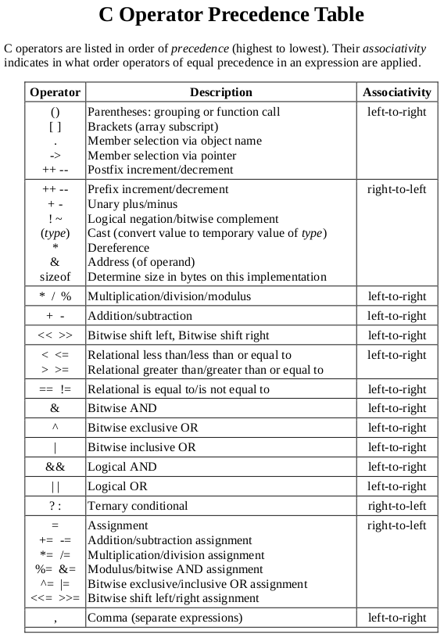
Gilles Carpentier ISEP
26

Slide 27
Examples :
x = y + z * k / m;
r = m | n & t ;
if( x>y || x<i && d )
int x=(1,2,3);

